Slide 1
Heart Disease Analytics
By Rima Nandy

Slide 2
Data Source
The Data Source is provided by various hospitals which is then collated and preprocessed by me using Python programming.

Slide 3
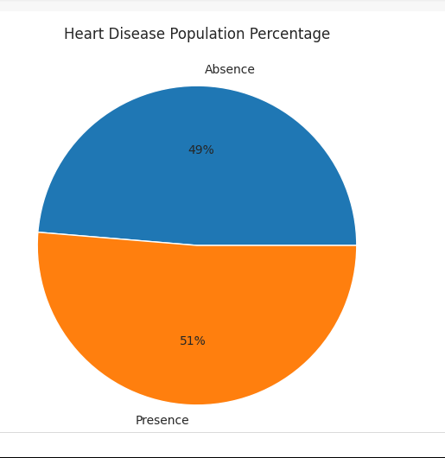
Heart Disease Population Percentage
People who have heart disease is 51% whereas people who donot have heart disease is 49%. Thus,the presence of heart disease is 2% higher than its absence.

Slide 4
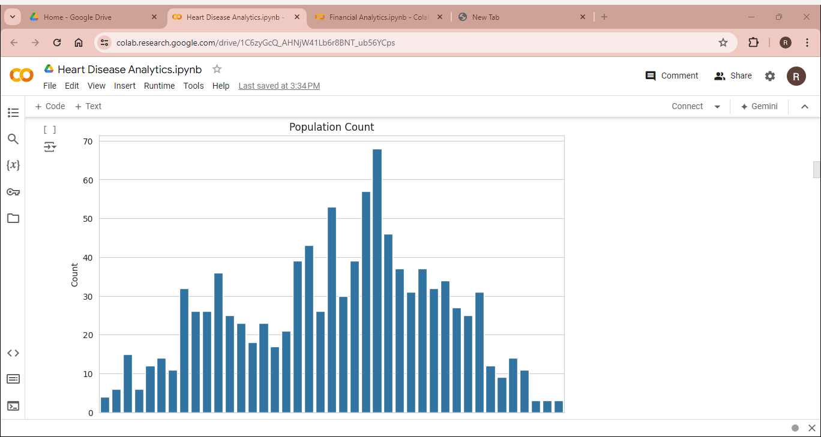
Count Plot of Population vs Age
Through the count plot of population, the entire population can be divided into 3 sections:
Young Age- Population with age>=29 and age<40
Middle Age- Population with age
>=40 and <55
Elderly Age- Population with age >55

Slide 5
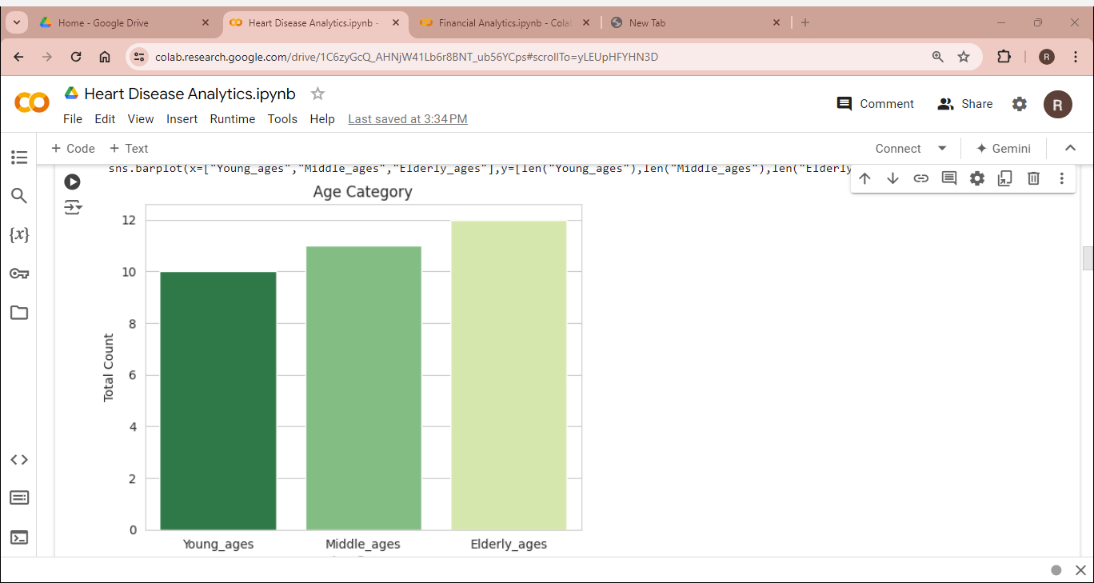
Bar Plot based on Age Category
Using Bar plot based on Age Category, it can be clearly said that the maximum population consists of Elderly Ages, viz, people with ages above the age of 55.

Slide 6
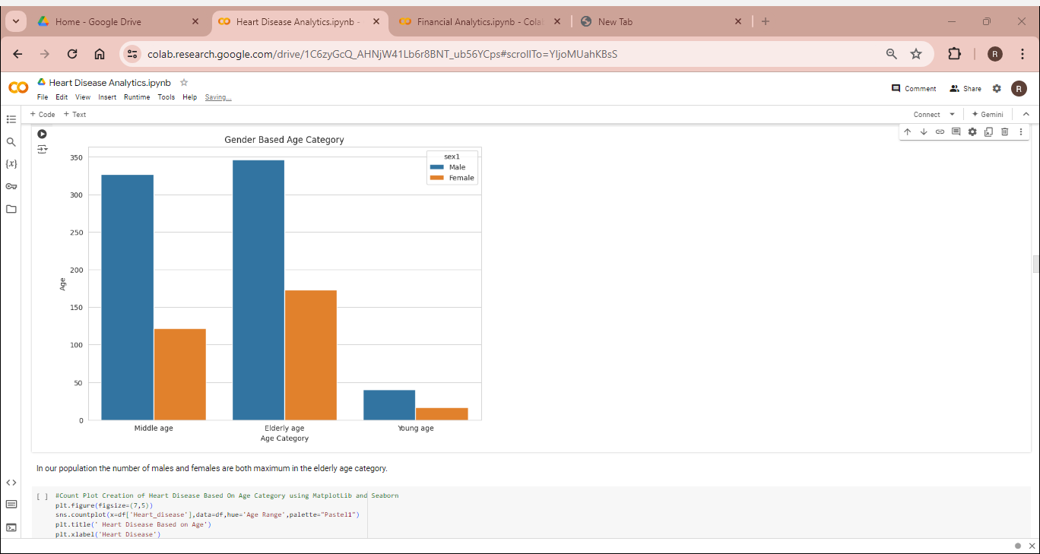
Count Plot Creation based on Age Category and Gender
In our data, the maximum number of population resides in the elderly category

Slide 7
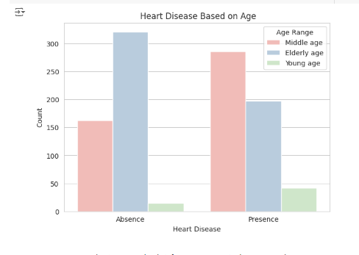
Heart Disease based on Age Category
From the count plot, it can be clearly be inferred that the middle aged people are more prone to heart diseases than any other age group.

Slide 8

Heart Disease based on Gender
We can see that females are more prone to heart disease than males.

Slide 9

Count Plot based on Chest Pain Experienced by Population
It seems people who have non anginal pain have a higher chance of heart disease.

Slide 10
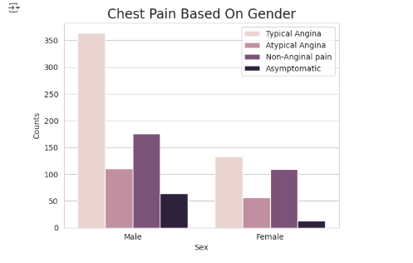
Count Plot creation of Chest Pain based on Gender
Males have a higher chance of suffering from typical angina than females.

Slide 11
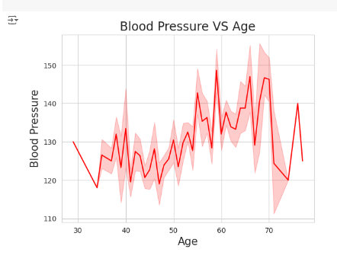
Blood Pressure vs Age
Here we can see blood pressure increases between 50-60 and the same pattern continues till 70 years of age.

Slide 12
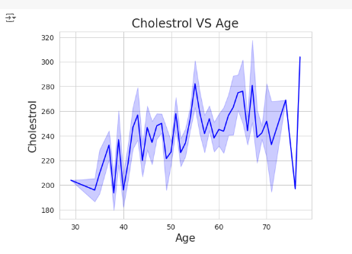
Cholesterol vs Age
The level of Cholesterol increases in the age group of 50-60 up to the age of 70.

Slide 13
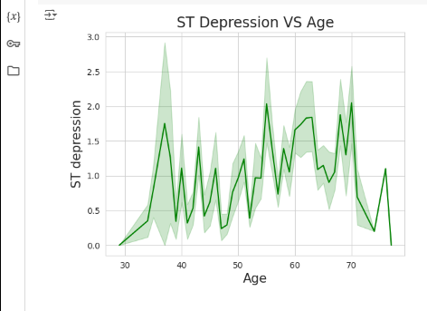
ST Depression Vs Age
The ST Depression is higher in the age group of 30-40 years.

Slide 14
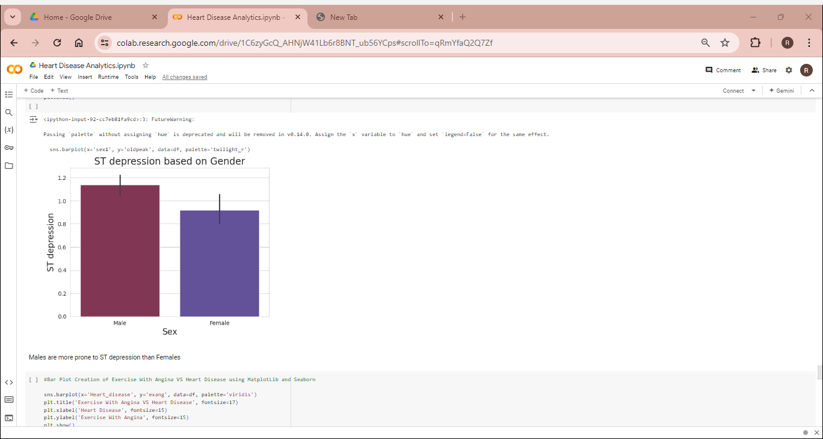
ST Depression based on Gender
Males are more prone to ST Depression than Females.

Slide 15

Exercise with Angina vs Gender
Males are more prone to exercise with angina than females.

Slide 16
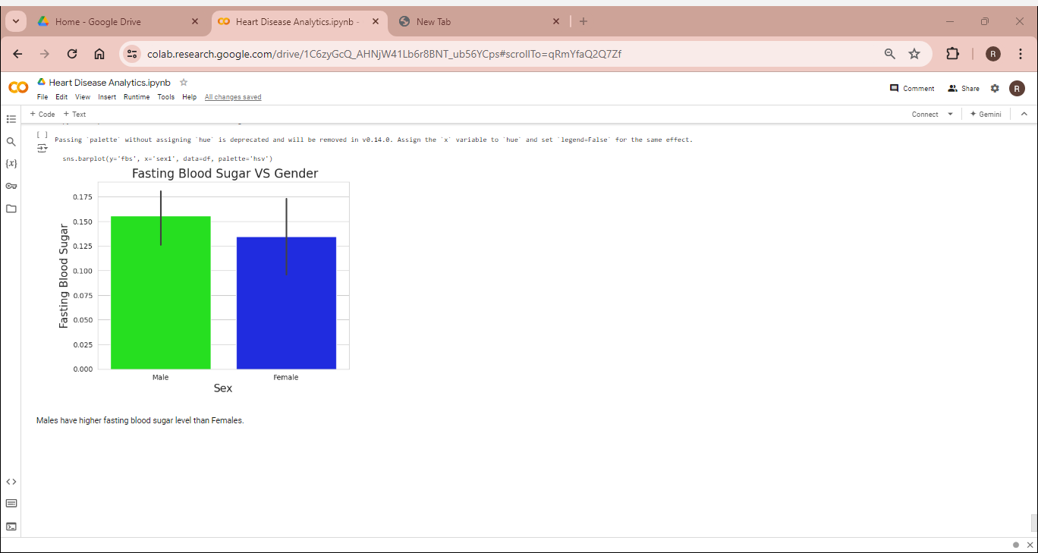
Fasting Blood Sugar vs Gender
Males have a higher fasting blood sugar than females.

Slide 17
Detailed Analysis
Thus, from the analysis, it can be clearly said that the level of cholesterol, fasting blood sugar levels, ST Depression, Blood pressure positively influences heart disease.
Males are more prone to cholesterol, high blood pressure, ST depression than females and hence have a higher risk of heart disease.
Heart diseases also affect the middle aged group of 40-55 years more than the older and younger groups.
Heart Diseases can also be suffered by people who show no typical pain of angina, therefore non-anginal pain due to its non-detection remains a larger cause for heart diseases.
Finally,51% of the population suffers from heart diseases, therefore one should maintain proper heart healthcare to prevent heart diseases.

Slide 18
Thank You

